Slide 1
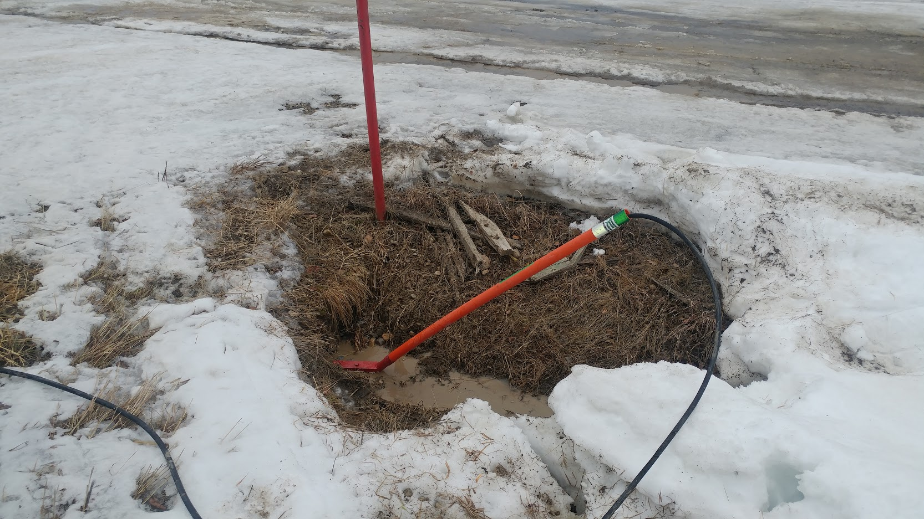
CULVERT CREEP
A new safety innovation that will save you money.

Slide 2
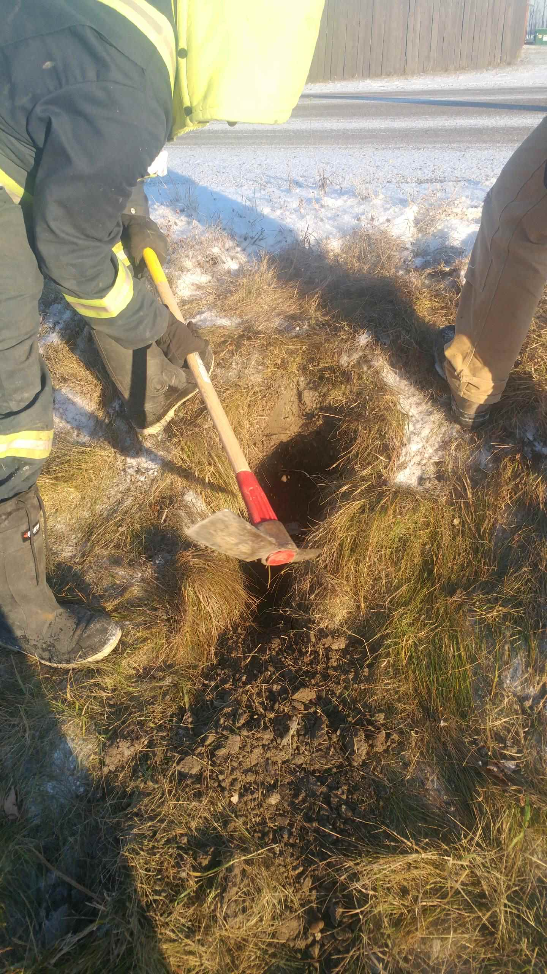
60 – 70% of the hours
spent thawing a culvert
are used to FIND IT first.

Slide 3
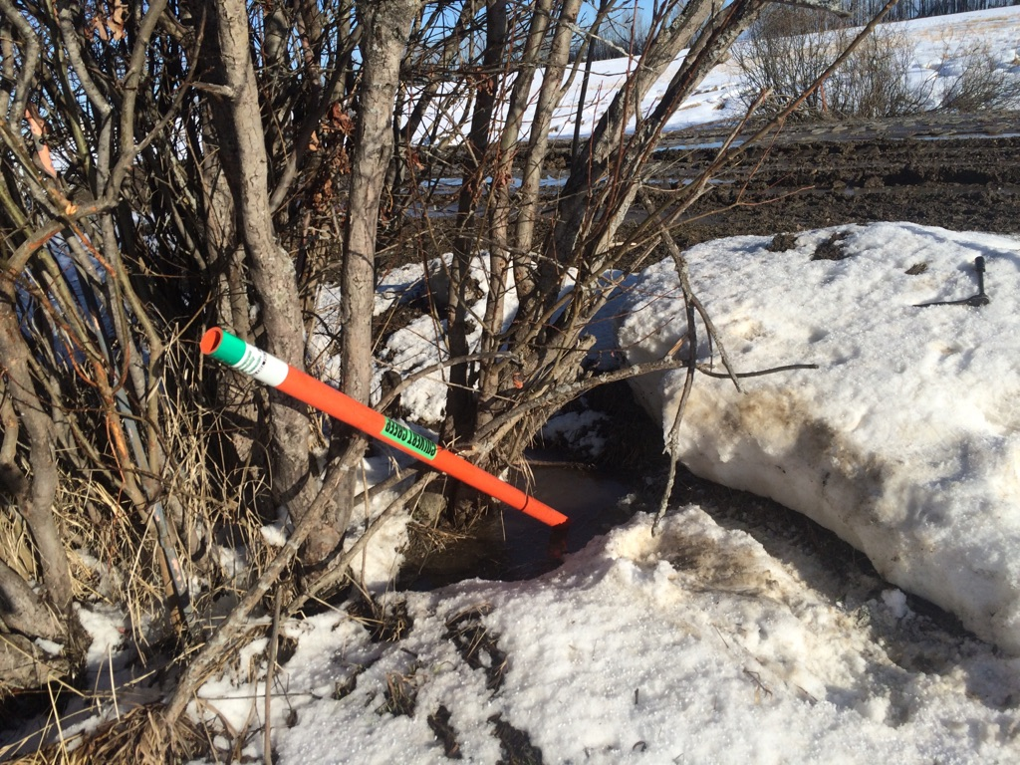
The Culvert Creep was specially designed for locating, snaking and thawing your culvert.
Having one will eliminate the need to thaw grader banks of ice and snow to LOCATE the culvert first.

Slide 4
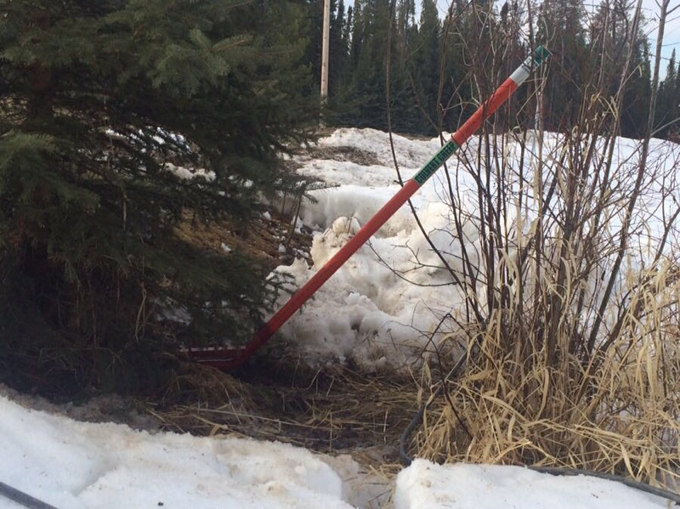
Hours can be spent probing on spring ice and snow banks to find the low end of the culvert to begin the thawing process…

Slide 5
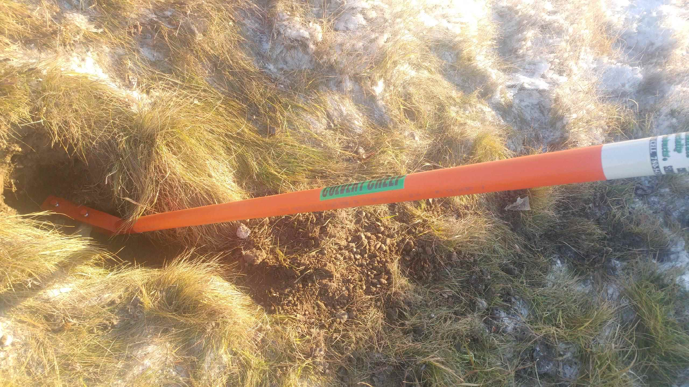
Older, well established roads are a prime candidate for a Culvert Creep. Over time, ditches fill in. Some culverts can be 1 – 3 feet below grade, making them especially hard to locate.

Slide 6
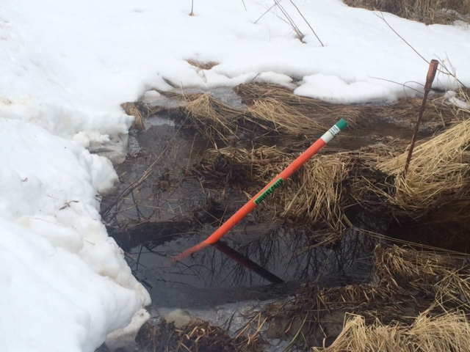
Hours can be spent searching for the culvert, and often the operator must reach into the cold water and ice to insert a crawl jet.
This creates a safety hazard, where the operator can be cut with sharp metal and ice.

Slide 7
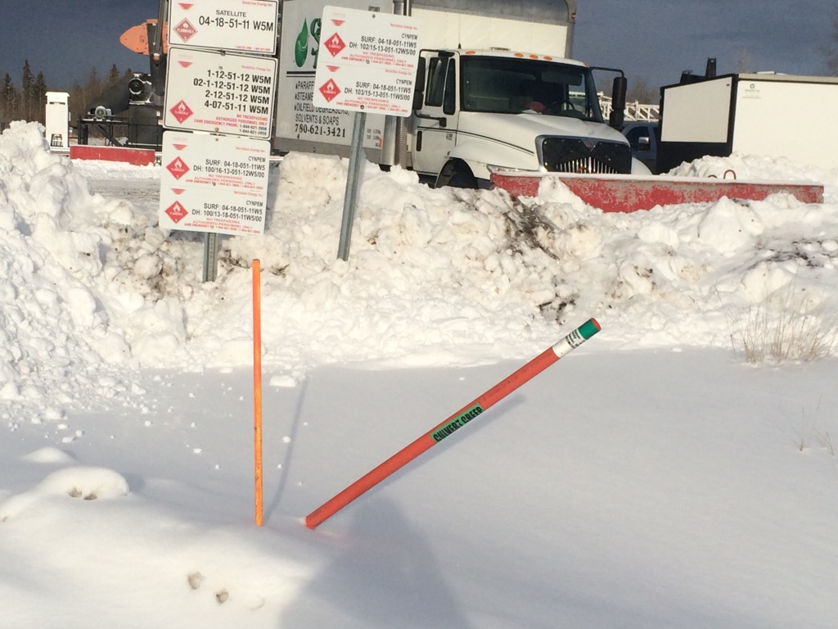
With a Culvert Creep installed, the operator simply inserts a crawler jet into the end of the Culvert Creep and it snakes into the culvert every time, thus beginning the thawing process…
Thawing a culvert is a quick job provided you can find the place to start!

Slide 8
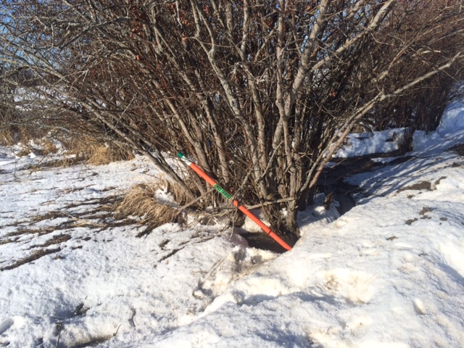
This culvert was located 20 feet away from where the operator was told to start searching…

Slide 9
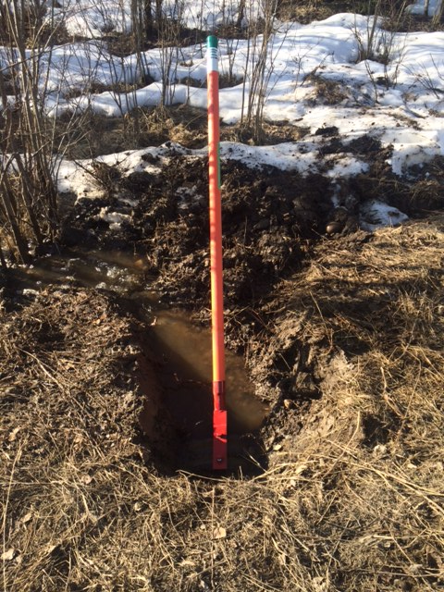
Even exposed ground can hide a culvert exceptionally well…
Installing a Culvert Creep marks the location, and makes for easy thawing access as it bypasses mud and debris that can block the culvert’s entrance.
No Ground Disturbance required.

Slide 10
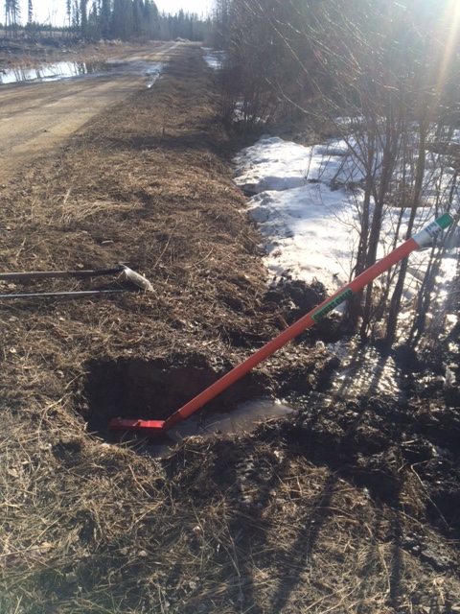
A metal detector was necessary to find this culvert. It wasn’t where it was supposed to be either…
Using a Culvert Creep makes thawing your culvert much more efficient, and far less expensive.

Slide 11
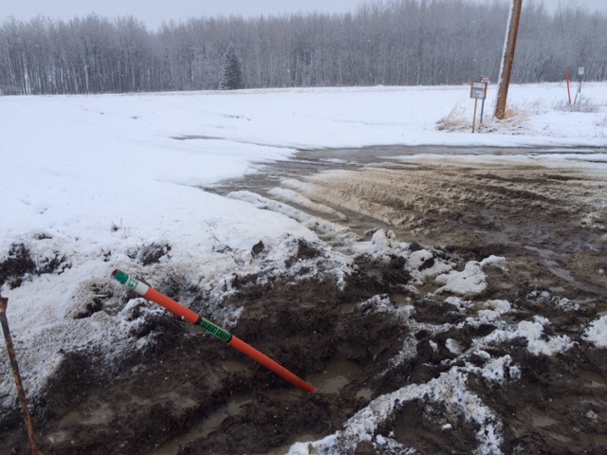
The previous culvert marker at this location was driven over and buried in the mud.
Using a Culvert Creep means increased visibility for all users, including road maintenance personnel.

Slide 12
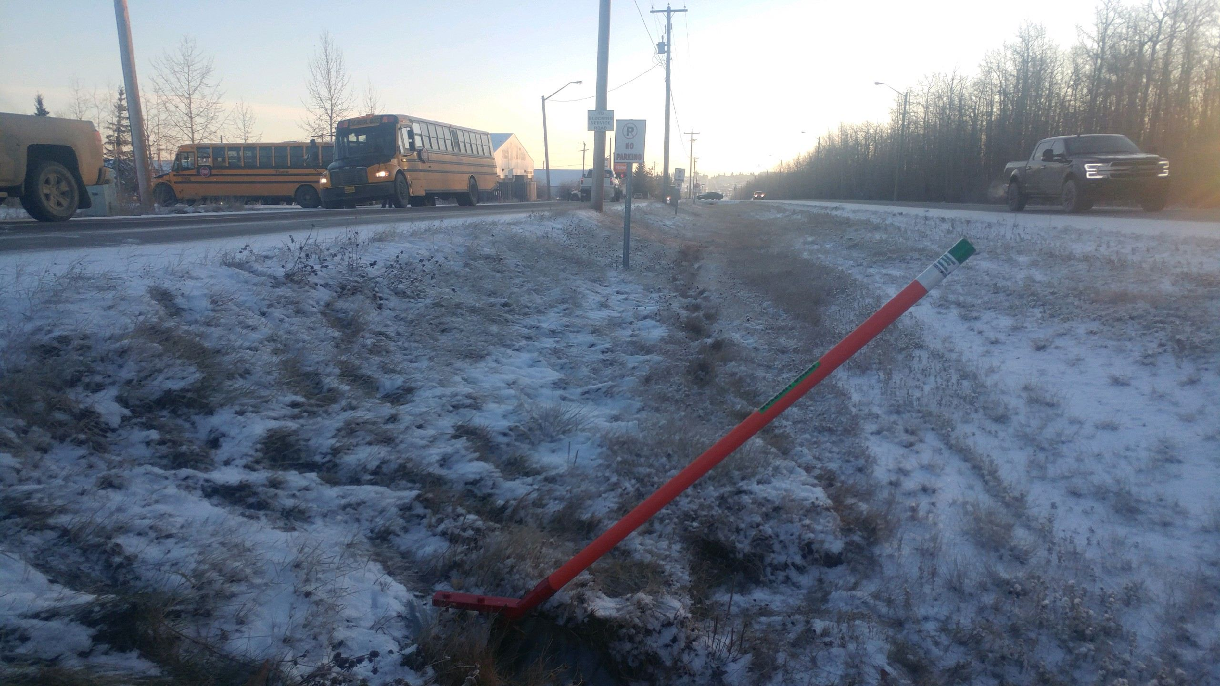
The Culvert Creep is designed at a 45° angle to keep it away from the grader, while allowing easy thawing access.

Slide 13
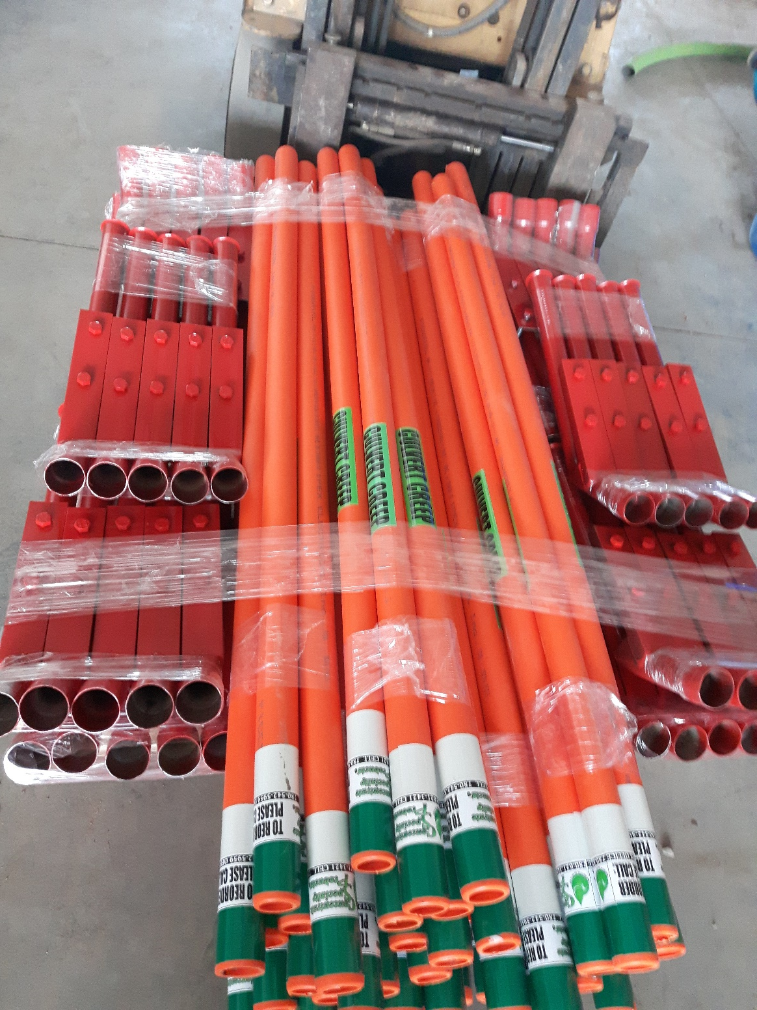
The Culvert Creep will:
REDUCE YOUR SERVICE COSTS
MAINTAIN ROAD INTEGRITY
KEEP WORKERS SAFE
- Various lengths available
- Installation available, as well as servicing, maintenance & thawing
- Volume purchase discount

